Slide 1
Machine Learning Class Fall 2025 Assignment 1
Instructor: Prof. Chun-Yi Lee (李濬屹)
TA Email: ml-elsalab@googlegroups.com

Slide 2
Rule
Deadline: 2025-10-10 23:59
You have a total of two extra days available for late submissions across all assignments
If you want to use late days for an assignment, please send an email to ml-elsalab@googlegroups.com specifying the number of late days you intend to use (in units of days)
If you have any questions related to the assignment
encourage you to post them in the discussion section on NTU Cool

Slide 3
Overview
Q1-Q4: Colab (75%)
Q1: Perceptron (10%)
Q2: Regression (15%)
Q3: Support Vector Machine (SVM + Kernels) (25%)
Q4: Tree-based Models (CART and Ensembles) (25%)
Q5: Kaggle Competition (25%+ Bonus: 20%)
Go Rank Prediction

Slide 4
Q1-Q4: Colab (75%)
Fill in all `# TODO` blocks. Answer bolded questions in this notebook.
Q1: Perceptron (10%)
Q2: Regression (15%)
Q3: Support Vector Machine (SVM + Kernels) (25%)
Q4: Tree-based Models (CART and Ensembles) (25%)

Slide 5
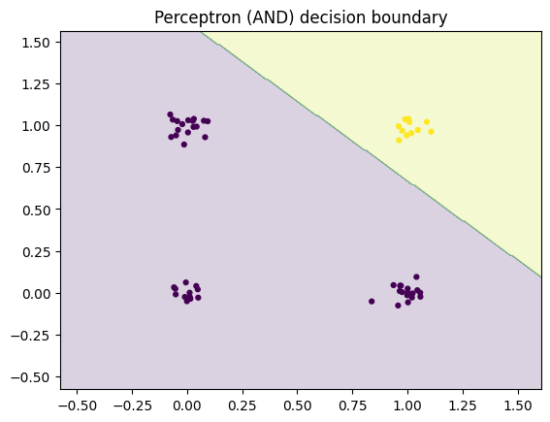
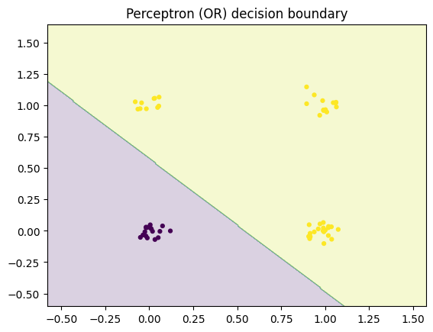
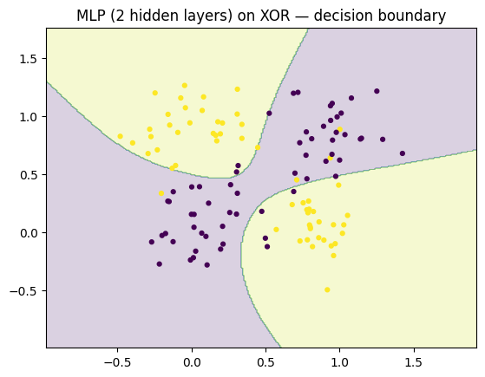
Q1
Part A: Single-layer perceptron
Required: Acc = 100% on both training and testing sets for each dataset
Part C: MLP with two hidden layers
Required: test acc ≥ 90% on the XOR dataset

Slide 6
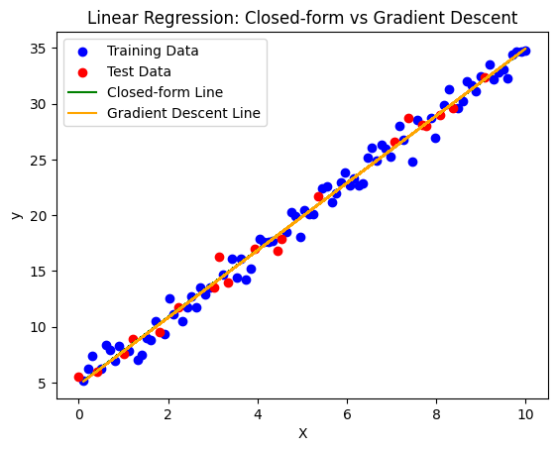
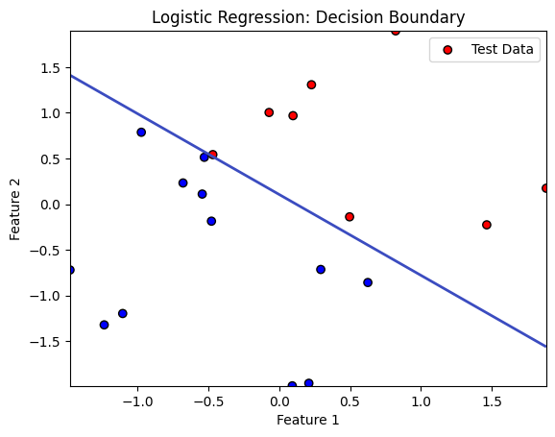
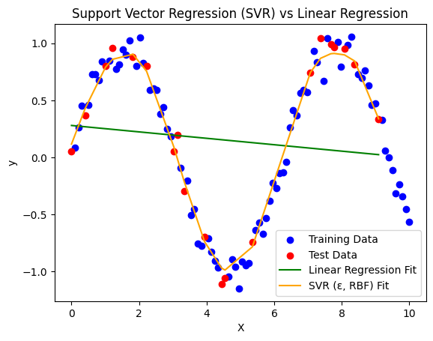
Q2
Part A: Linear Regression(LR)
Required: test MSE < 0.65 for both method
Part B: Logistic Regression
Required: 100% accuracy on the test set
Part C: SVR
Required: MSE < MSE_LR and MSE < 0.05

Slide 7
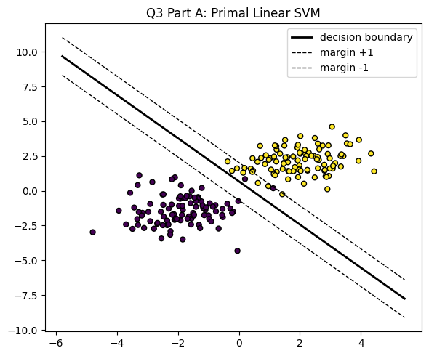
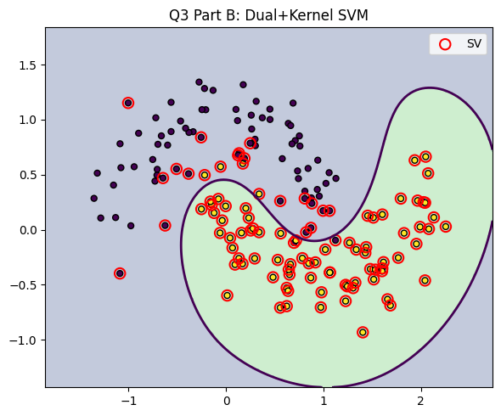
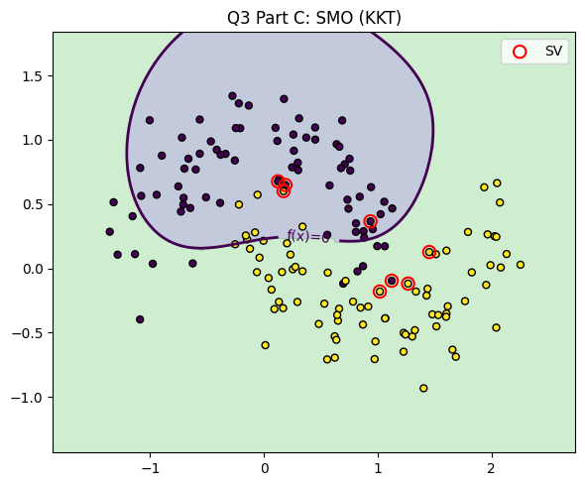
Q3
Part A: Primal Soft-margin Linear SVM
Required: ≥ 95% training accuracy on the provided dataset
Part B: Dual + Kernelized SVM
Required: ≥ 90% test accuracy on the provided dataset
Part C: Dual + Kernel C-SVM via SMO with Explicit KKT Checks
Required: ≥ 90% test accuracy on the provided dataset

Slide 8
Q4
Part A: CART
Classification: test accuracy ≥ 0.90
Regression: test MSE < 0.10
Part B: Pruning (Generalization of Trees)
Classification: After pruning, training accuracy decreases while test accuracy increases
Regression: After pruning, training MSE increases while test MSE decreases
Part C: Random Forest: Bagging, OOB, and Feature Importance
Classification: Random Forest test accuracy must be higher than a single tree.
Regression:
In the 2D regression case, Random Forest test MSE must be less than a single tree.
Importance values should reflect that feature x0 (sin term) dominates, with x1 (linear term) still contributing.

Slide 9
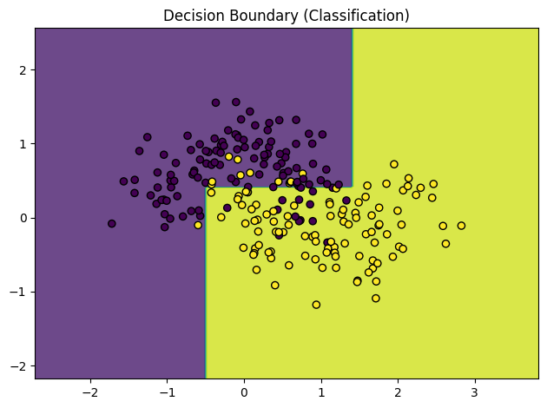
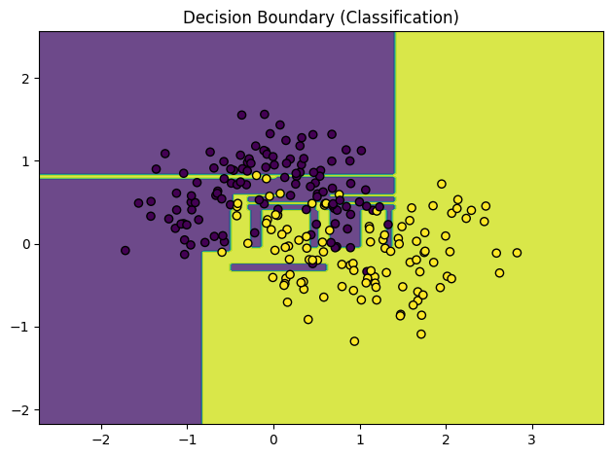
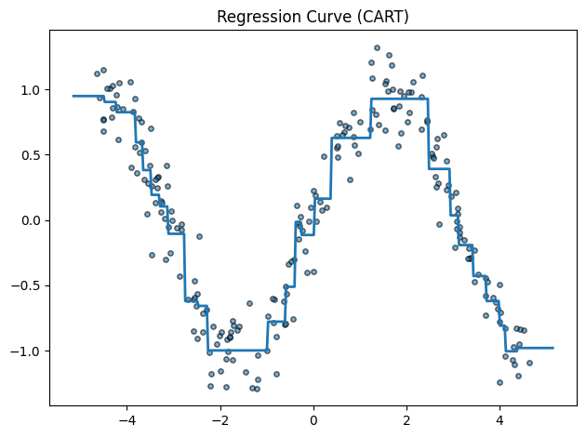
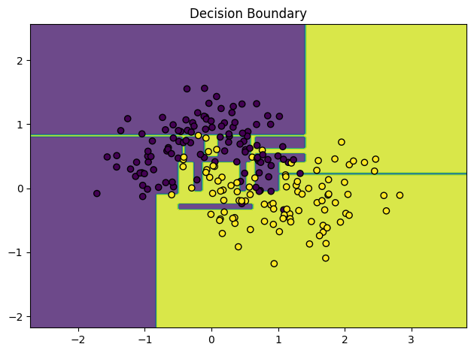
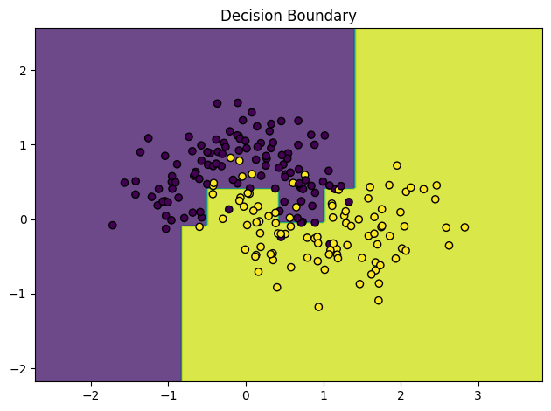
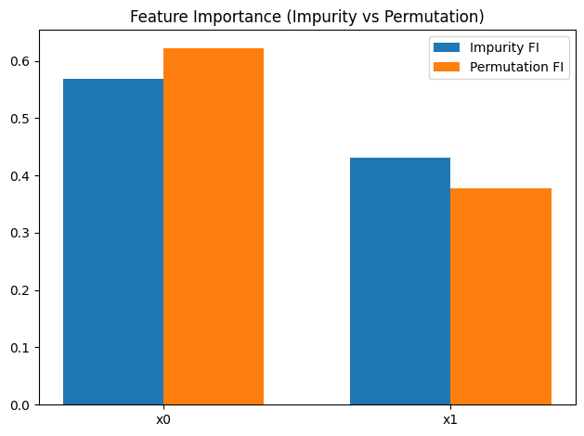

Slide 10
Q5: Kaggle Competition (25%+ Bonus: 20%)
Please use your student ID as the team name.
If you are an auditor, add _a after your student ID (e.g., b12345678_a).
Each team may submit up to 10 times per day.
Go Rank Prediction

Slide 11
Q5
https://www.kaggle.com/competitions/machine-learning-class-fall-2025-assignment-1-q-5/overview
Go Rank Prediction
Based on the given features, output the rank (1–9) of each testing file.

Slide 12
Training set
There are total 9 files, each containing 4500 games from players of a specific rank.
For example: log_9D_policy_train.txt contains data from 9-dan players, log_8D_policy_train.txt from 8-dan, and so on
In every game, both players belong to the same rank

Slide 13
Testing Set
There are total 458 files, each containing several games from players of a specific rank
For example, 1.txt may contain n games from players of rank 2, 2.txt may contain k games from players of rank 9, and so on
Your goal is to predict the rank of each file
In every game, both players are of the same rank

Slide 14
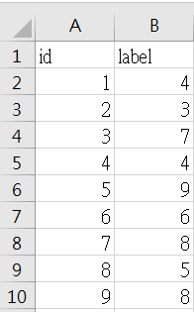
Submit
You must submit your prediction results (e.g., submission.csv) to Kaggle
Refer to the submission_sample.csv provided on the website to check the required upload format

Slide 15
Reference
The following papers may help you design features and choose appropriate methods
“Determining player skill in the game of go with deep neural networks.“, Springer International Publishing, 2016.
“Strength Estimation and Human-Like Strength Adjustment in Games.”, ICLR 2025
“Examination of Indicators for Estimating Players’ Strength by using Computer Go”, TAAI 2018
“Policies of Multiple Skill Levels for Better Strength Estimation in Games.“, arXiv preprint arXiv:2505.00279 (2025)

Slide 16
🎮 Enjoy the assignment! 😃

